Slide 1

Integrating Globus into Galaxy to Enable FAIRifying Data
&
Globus + Galaxy + Personal Genomes Project + FAIR
Rick Wagner
rick@globus.org

Slide 2
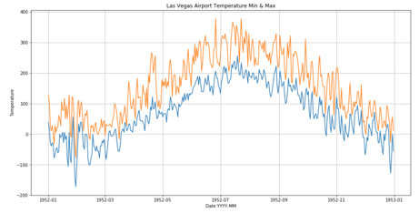


A simplistic data flow…
Data Repository
Request
Analyze
Dataset
Shared endpoint
Dataset
Users should be able to reliably transfer data as part of workflows
Enables simple sharing of workflow results

Slide 3
Plan
Document Globus Auth configuration in Galaxy
Pick a Galaxy workflow to adapt
Install necessary tools
Host input data on remote Globus endpoint
Create a Galaxy tool for Globus Transfers
Install new tool into workspace
Add step in sample workflow to transfer input data
Validate the workflow runs correctly with remote data
Stretch: Tool for sharing results

Slide 4
Help Desired
Galaxy Training:
What’s a good “Hello, World!” workflow for adapting?
Galaxy tool development
Help with tool packaging, good examples
Access user credentials
Example of Calling external APIs

Slide 5
Globus + Galaxy + Personal Genomes Project + FAIR

Slide 6
Making PGP data available FAIRly
We looked at PGP data and could not find APIs for “Finding” and ”accessing” the data
Register the data at biocaddie, CEDAR or any other data repositories
Reach out to PGP team to set up a Globus endpoint serving the data
Get a Galaxy workflow to analyze the data from PGP and make the results “Findable, Accessible and Reusable”
Create containers for various analysis tools and workflows
Generate identifiers for datasets and tools
Perform FAIRness Assessment

